Slide 1

MU5MEF16 - (MEC 655) Numerical Methods for Fluid Mechanics
Comp Mech
Collapse of a column of grain
DUVIVIER Valentin
11/08/2021

Slide 2
Plan
Collapse - rheologies
μ(I) - rheology
Numerical implementation
Level refinement
Aspect ratio
Size grain
Consistency model : Discrete solid case
Conclusion

Slide 3
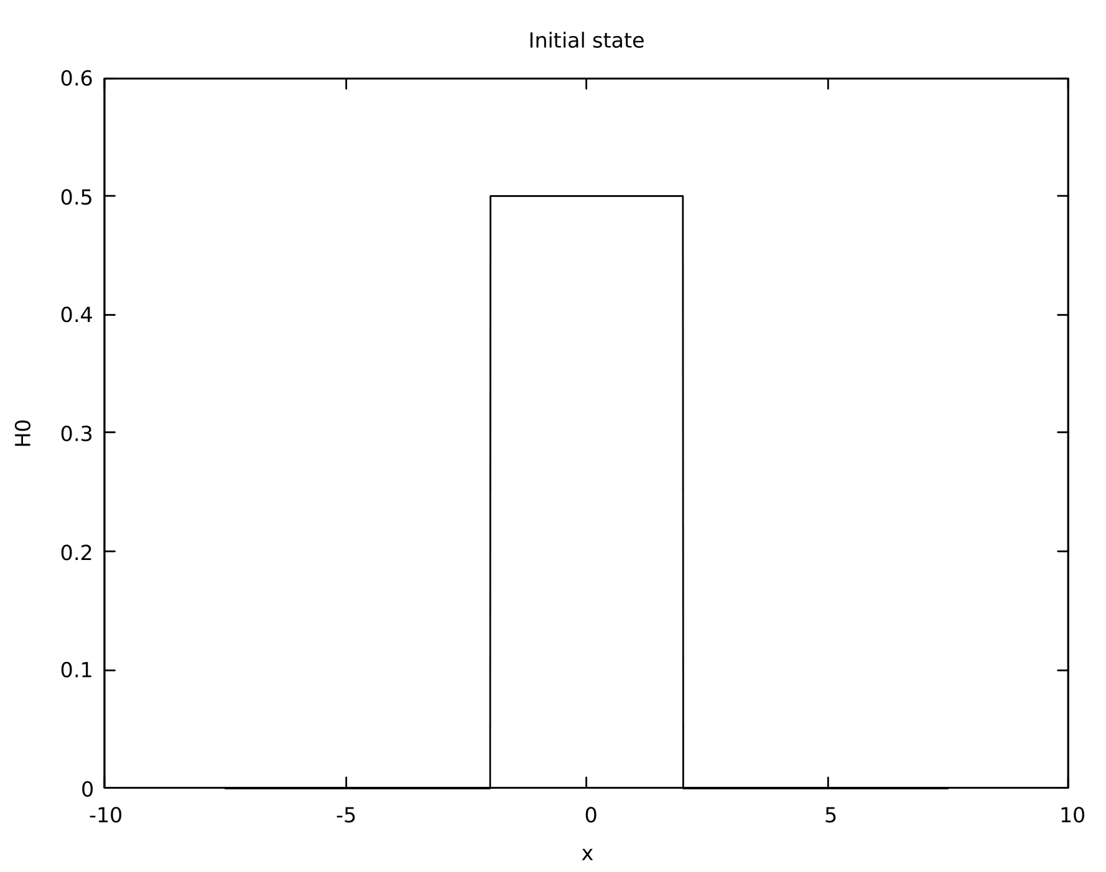
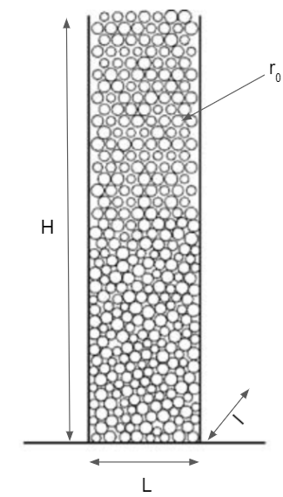
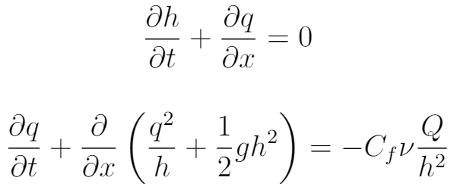
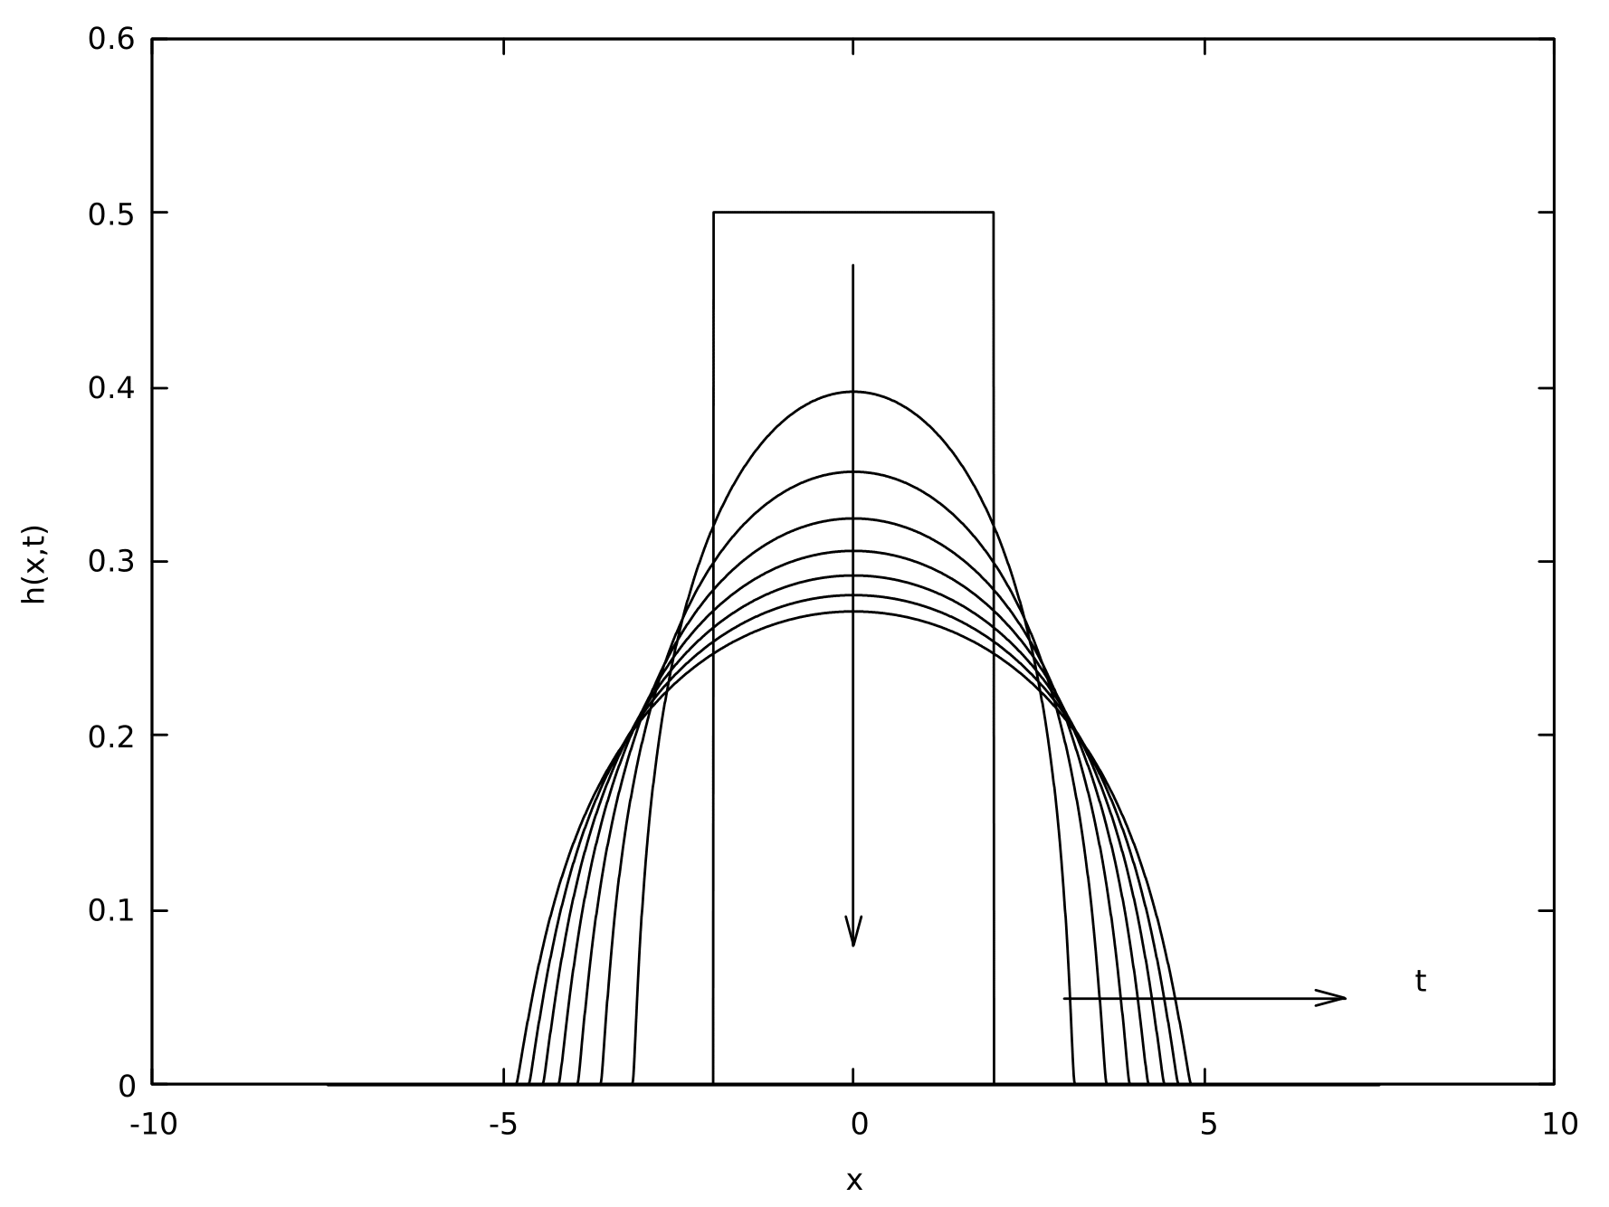

Recall 1st problem
fig 1b : fluid system
Convective terms
Poiseuille viscous term
fig 1a : general problem

Slide 4
Navier-Stokes
constant viscosity
stability can’t ensure good physics
not well adapted for our case
fig 2 : Navier-Stokes

Slide 5
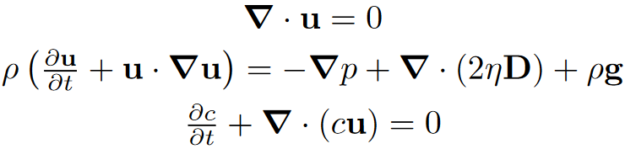
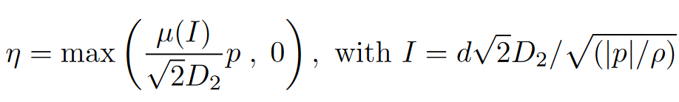


Numerical implementation
incompressible
movement quantity conservation
color function

Slide 6
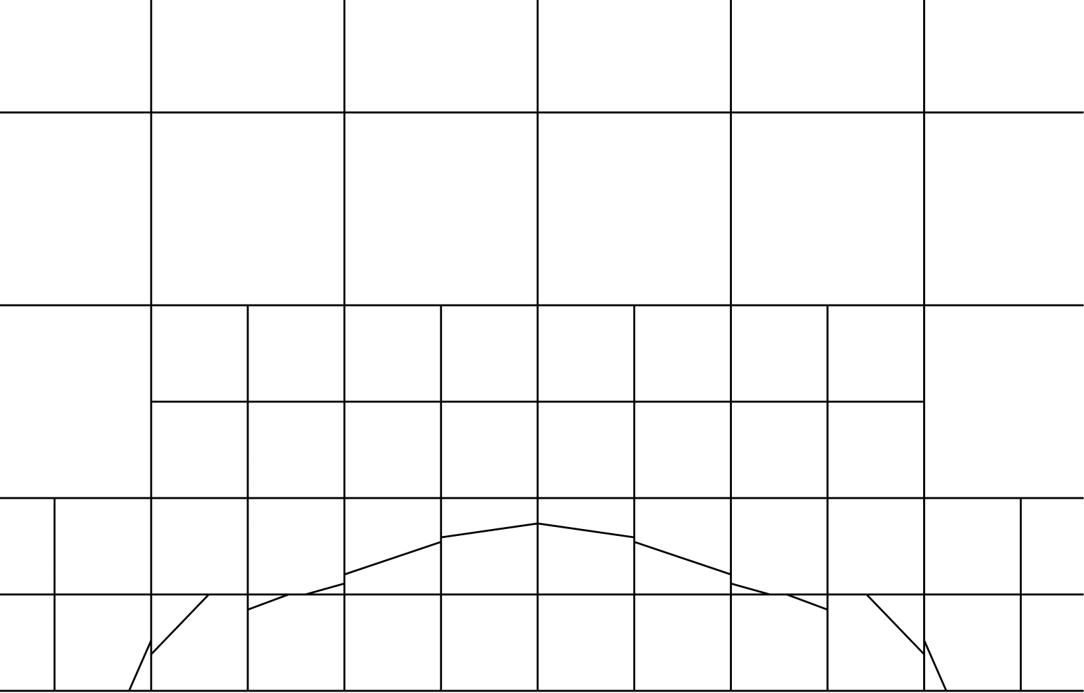
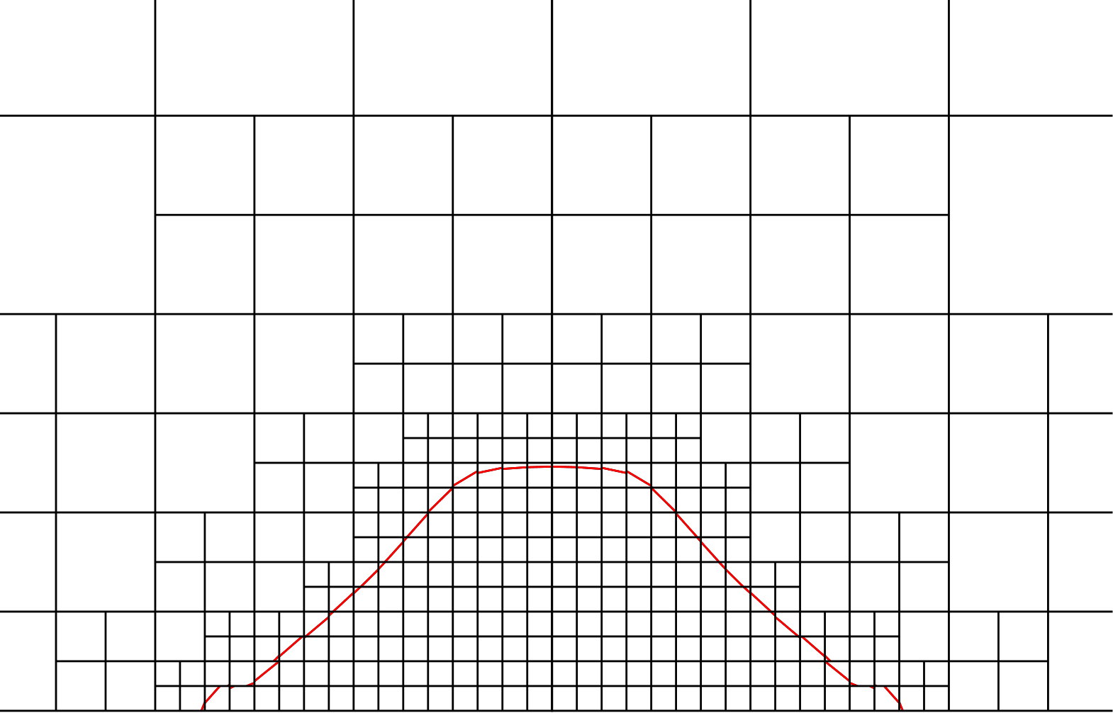
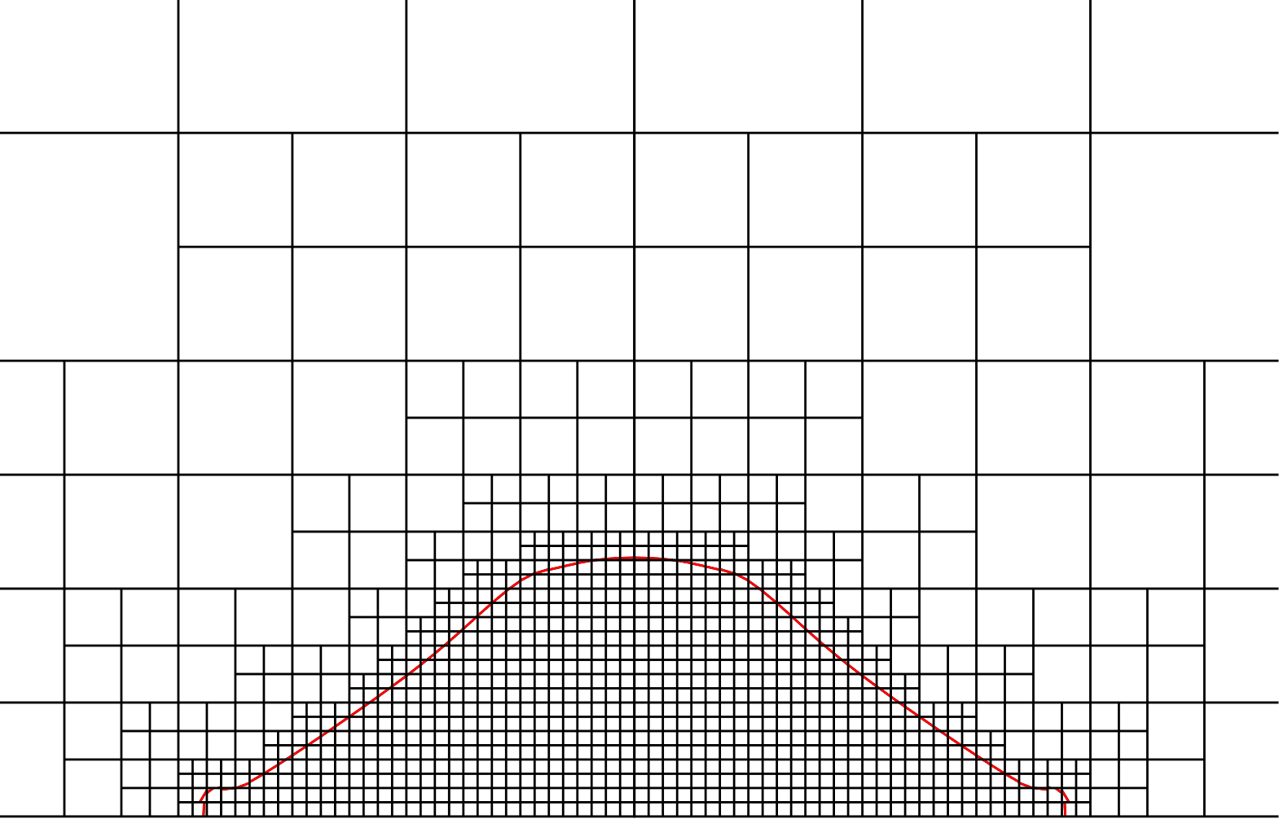
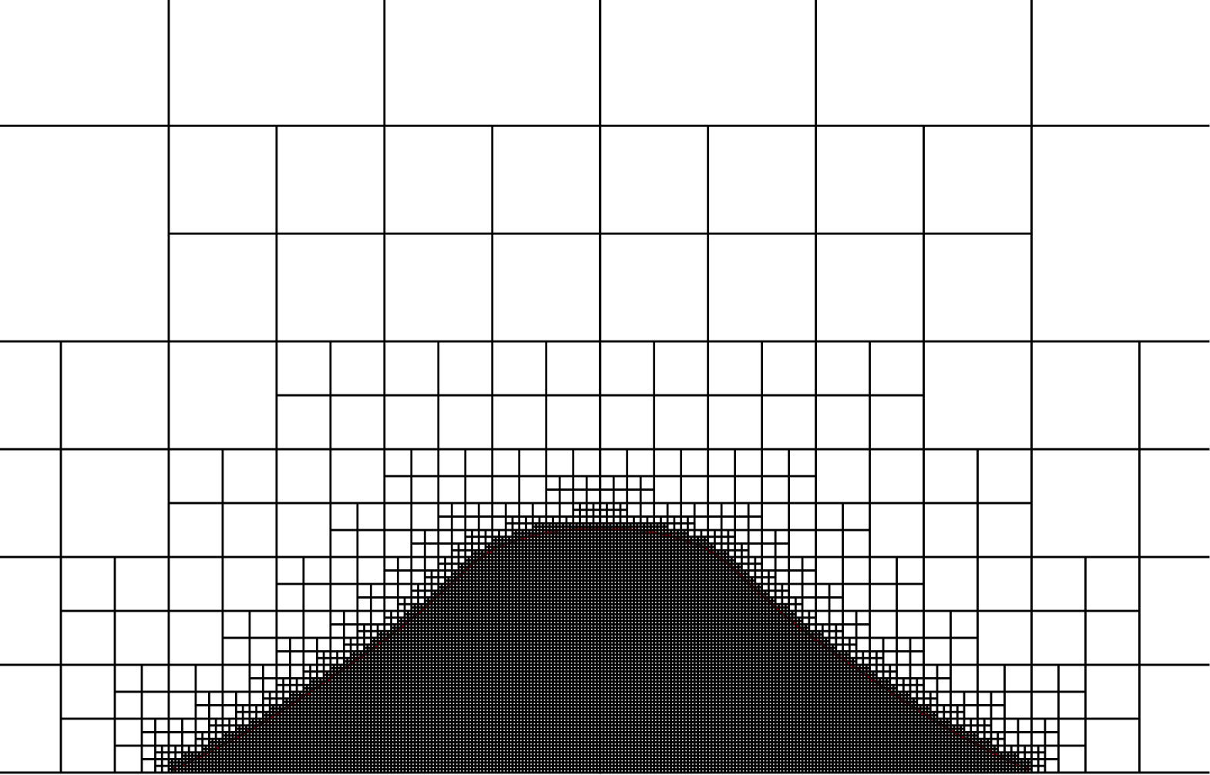
Refinement
fig 3a : LEVEL=5
fig 3b : LEVEL=7
fig 3c : LEVEL=8
fig 3d : LEVEL=10

Slide 7
Aspect ratio
fig 4a : ratio 10/1
fig 4b : ratio 5/1
physical behavior for several ratio
LEVEL=10
d_{grains} = 0.04 m
fig 4c : ratio 1/1

Slide 8
1st Balance sheet
Refinement adapted from LEVEL = 8
method good for several aspect ratio
What details on solid influence ?

Slide 9
Size grains
fig 5a : d_{grains} = 0.08 m
fig 5b : d_{grains} = 0.16 m
fig 5c : d_{grains} = 0.50 m
fig 5d : d_{grains} = 1.50 m

Slide 10
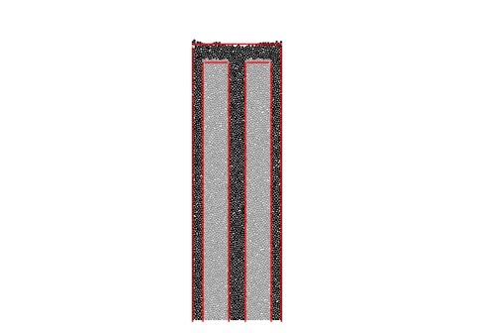
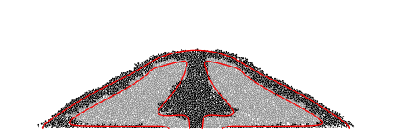

Discrete solid case
μ(I) rheology
μ(I) vs discrete mechanics
inner and outer behavior

Slide 11
Conclusion
Recovery of most the shape
Model developed last decade → more to come from slender approach
Combinatory behaviors and approaches

Slide 12
Bibliography
http://www.lmm.jussieu.fr/~lagree/TEXTES/PDF/JFMcollapsePYLLSSP11.pdf#cite.midi04
http://www.lmm.jussieu.fr/~lagree/SOURCES/GERRIS/BAGNOLDP/BAGNOLDP.pdf
http://basilisk.fr/sandbox/M1EMN/Exemples/granular_column_cohesif.c#if-quadtree
http://basilisk.fr/sandbox/M1EMN/Exemples/bingham_collapse_noSV.c

